Slide 1
Interpretability and Explainability
Introduction to Deep Learning: Class 3.2
Gradient-Based Methods

Slide 2
Module Agenda
Experiment Tracking (Lecture 3.1)
Monitoring/Observability (Lecture 3.1)
Explaining model predictions (Lecture 3.2)
Profiling

Slide 3
Pre-read
Gradient-based Explainability methods:
Integrated gradients paper
Smilkov et al. (2017) — “SmoothGrad: removing noise by adding noise”
Shows why raw gradients can be noisy and how noise-averaging can stabilize gradient-based saliency
Adebayo et al. (2018) — “Sanity Checks for Saliency Maps”
Demonstrates that some saliency methods can look plausible yet be weakly tied to model/data; introduces practical checks.
Adversarial Attacks:
Szegedy et al. (2013) — “Intriguing properties of neural networks”
Goodfellow, Shlens, Szegedy (2014) — “Explaining and Harnessing Adversarial Examples” (FGSM)
Carlini & Wagner (2016/2017) — “Towards Evaluating the Robustness of Neural Networks” (C&W attack)

Slide 4
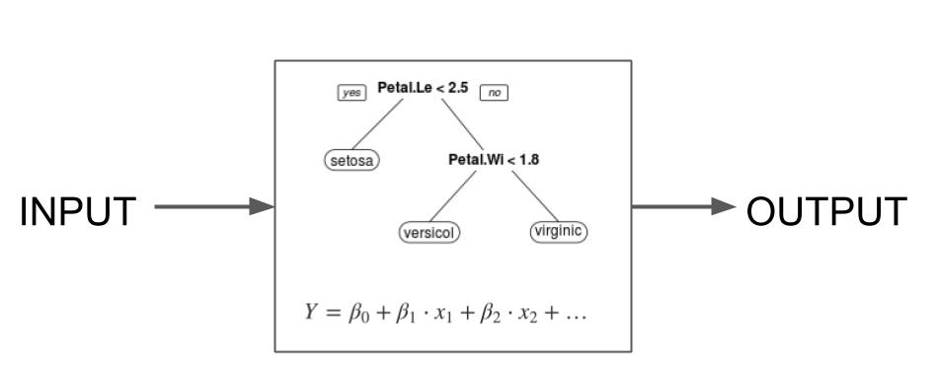
Interpretable ML Models
Why is a ML model making a certain prediction? Is it learning the right thing?
Inherently/Intrinsically Interpretable
Some models are interpretable by design. Eg., linear regression models and gradient boosted trees. Other architectures eg., neural networks require specialized methods to understand their predictions
Model specific vs. Model agnostic
Model agnostic methods treat the model as a black box and analyze how the model output changes in response to a perturbation in model input. Eg., ICE, PDP, Shap.
Model specific methods use knowledge of the model architecture. Eg., integrated gradients for neural networks
Local vs. Global
Local: Explain individual predictions
Global: How features influence predictions on average

Slide 5
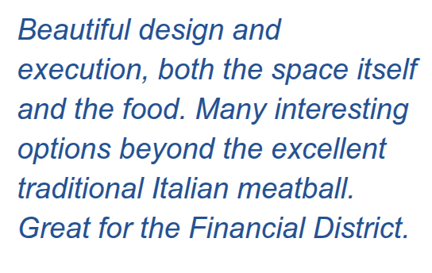


Interpretability in Neural Networks
Model prediction: Fireboat
Model prediction: Shoe
Why did the model label this image as a fireboat?
Why did the model label this image as a shoe?
Why did the model label this text as a positive sentiment?

Slide 6
Interpretability and Attribution
Interpretability can be thought of as an attribution problem:
Attribute the model’s prediction on an input or features of the input
Eg:
Attribute an object recognition network’s output to input image pixels
Attribute a sentiment analysis classifier’s output to individual words
Interpreting a network’s prediction helps us build confidence in its output
So how do we do this?
We could vary each input feature, run the modified input through the network and see how the network output changes (similar to ICE/PDP we considered in the previous class).
Issues with this approach:
Features can be correlated. Changing one feature independently of others can result in unrealistic input points. We also saw this with ICE/PDP
Running forward pass on a neural network is computationally expensive.

Slide 7
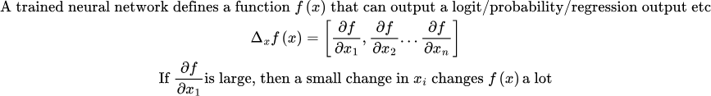
Why gradients give explanations..
Where do we get these gradients? Backpropagation gives them to us for free!

Slide 8
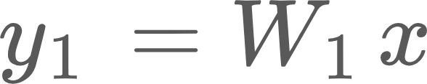


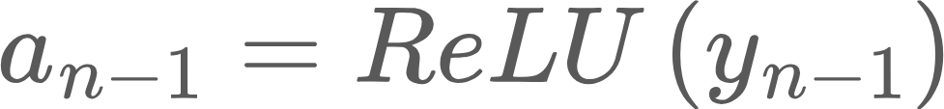
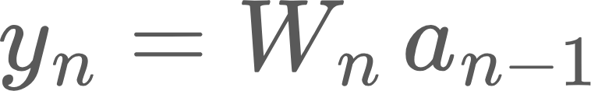








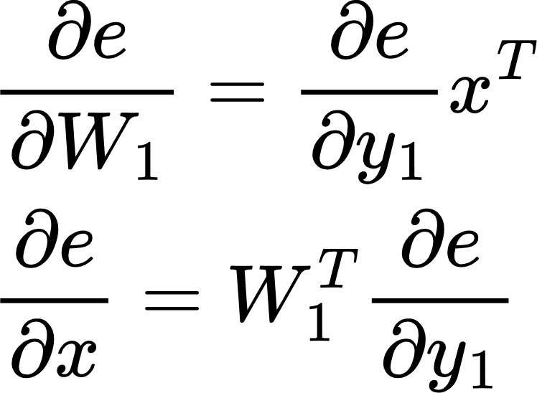
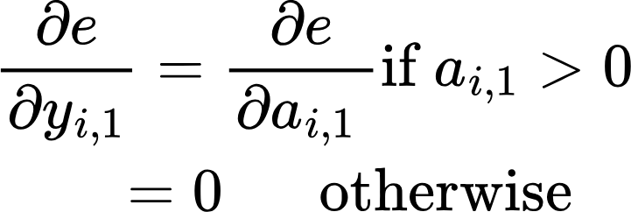
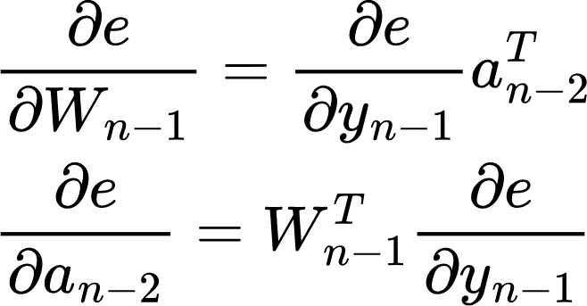
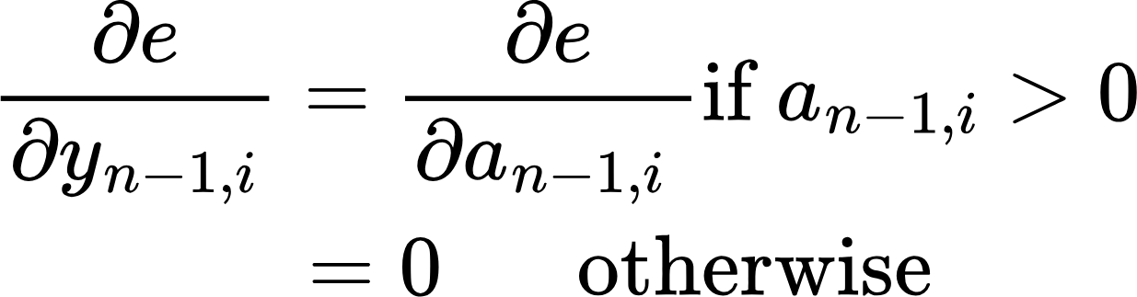
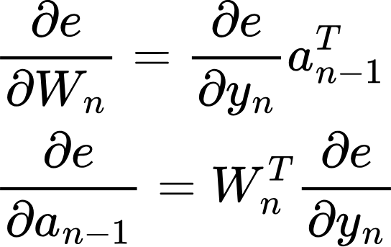
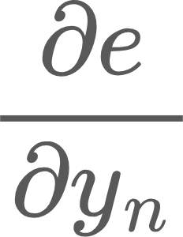
Backpropagation
Forward Pass or Inference
labels
ReLU
ReLU
Loss function (L)
…
Error
e = L(y)
Layer 1
Layer n-1
Layer n
Backward pass
(Training)
No parameters!
Notice we need the output of the previous layer in the backward pass!
Sent back to previous layers
Forward and Backward pass on a n layer network and using backpropagation to update weights
Used to update the weights of this layer

Slide 9
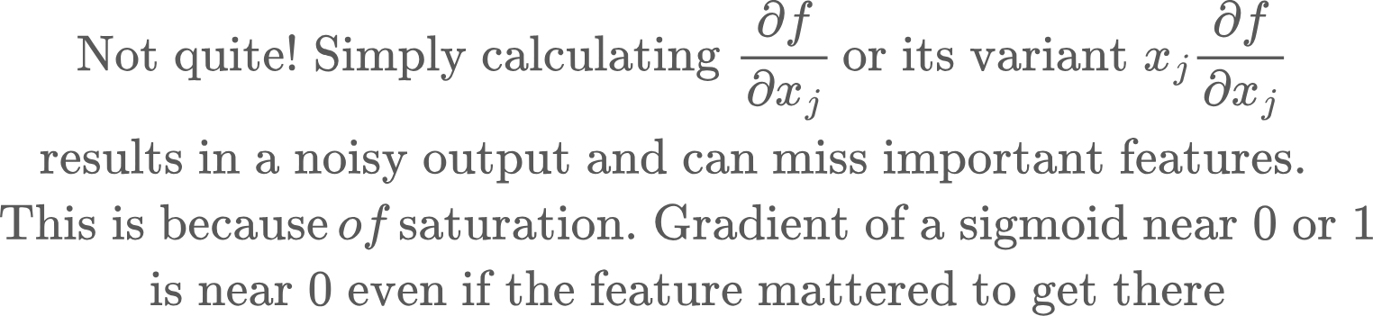
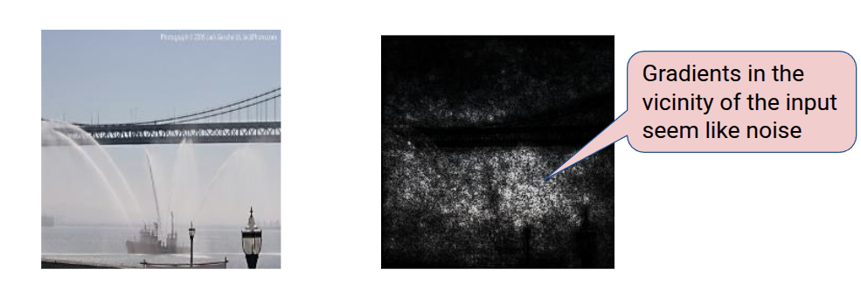
Does gradient wrt Input do the job?

Slide 10
Integrated Gradients
Rather than just look at the input, first define a baseline, a feature-less input that results in a neutral prediction. Eg., a black image for image-based models, a zero embedding vector for text models
Integrated gradient then explains
Model (input) - Model (baseline)
We vary the input from baseline to desired input in steps, then calculate and accumulate gradient of the network output against each input along the way. This way final feature attribution reflects contributions made “along the way” rather than just features with high gradients for the final image

Slide 11
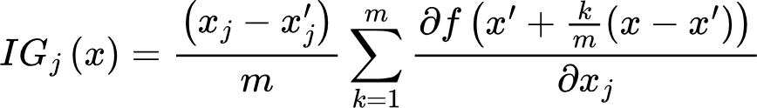
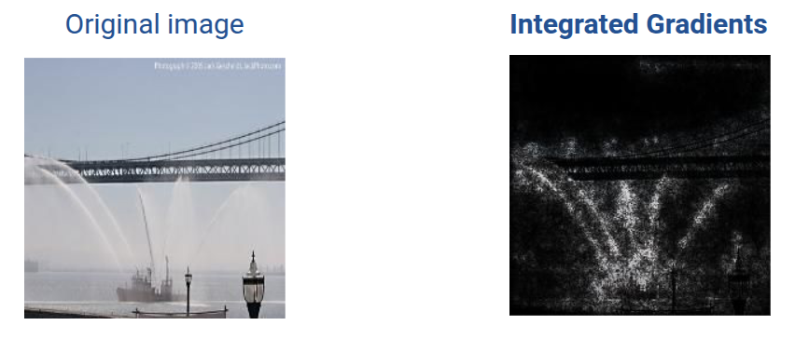
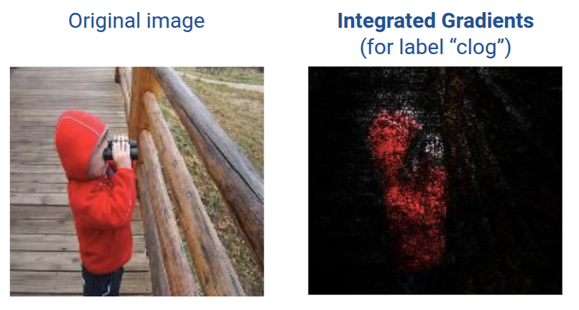
Integrated Gradients
Interpolated input at step k
feature j

Slide 12
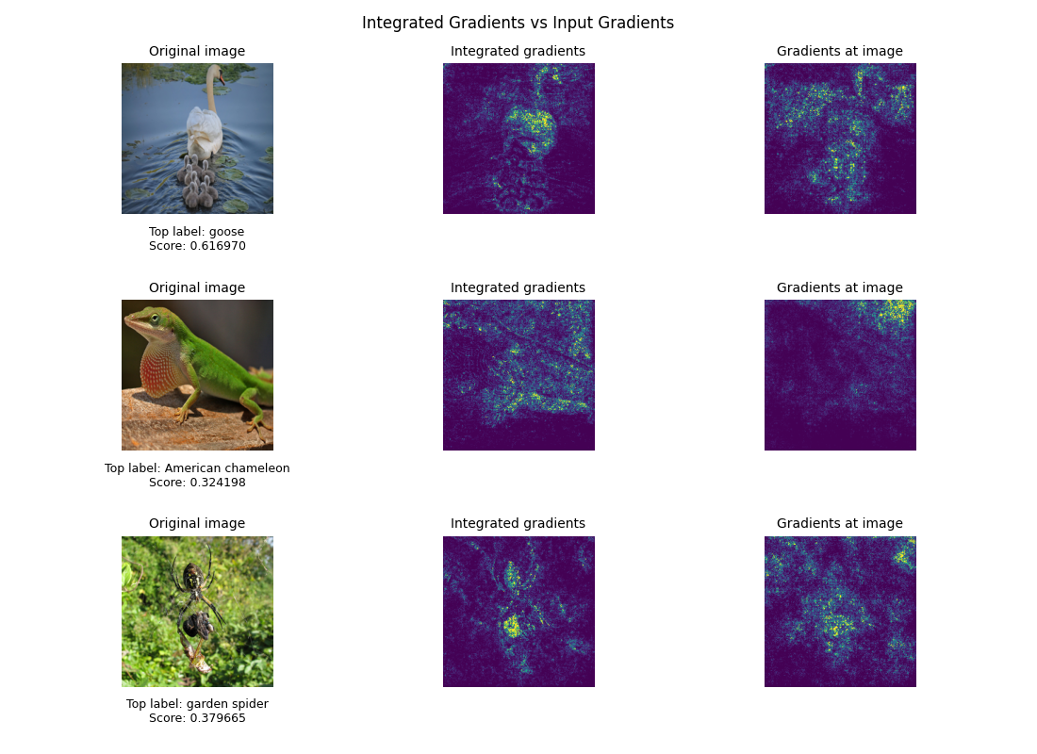
Few more examples

